Slide 1





VidChapters-7M: Video Chapters at Scale
Antoine Yang, Arsha Nagrani, Ivan Laptev, Josef Sivic, Cordelia Schmid
Project page: https://antoyang.github.io/vidchapters.html
Paper: https://arxiv.org/abs/2309.13952

Slide 2
Video Chapter Generation
Goal: improve navigation in long videos.
Task: segment a long video into segments and generate a chapter title for each.

Slide 3
Data collection procedure
Large pool of 92M YouTube videos [1]
Download description + check presence of chapters
Smaller pool of 817K videos with chapter annotations
[1] MERLOT Reserve: Neural Script Knowledge through Vision and Language and Sound, R. Zellers et al, CVPR 2022.

Slide 4
Data statistics
817K videos & 7M chapters
8 chapters per video (avg)
Chapter duration (avg): 142s
Video duration (avg): 1354s
97% videos with ASR
93% videos in English

Slide 5
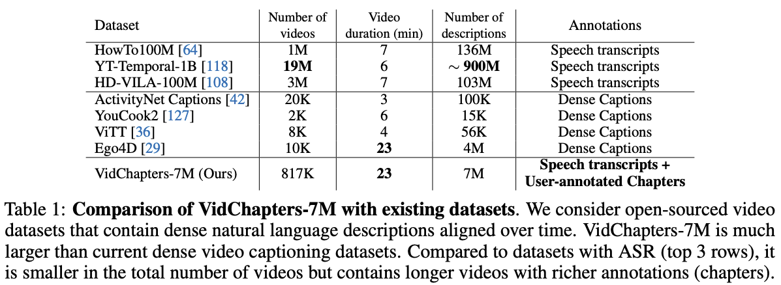
Comparison with other datasets

Slide 6
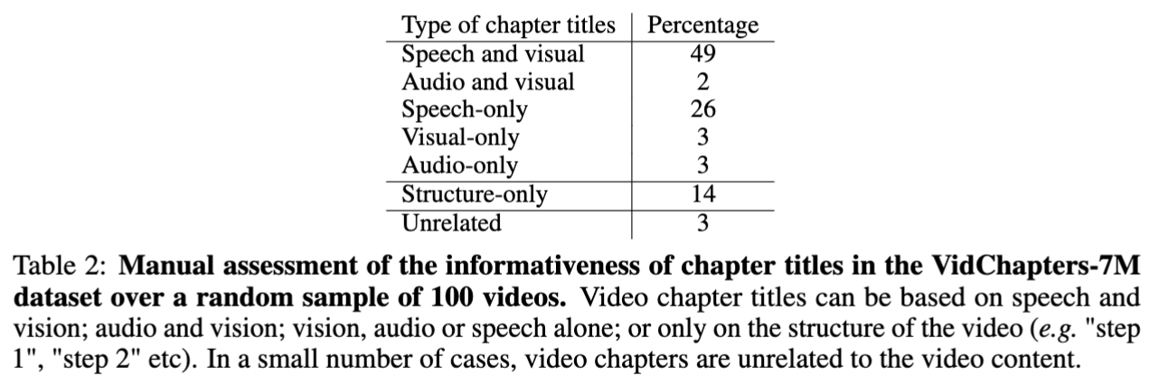
Manual assessment

Slide 7
New benchmarks

Slide 8
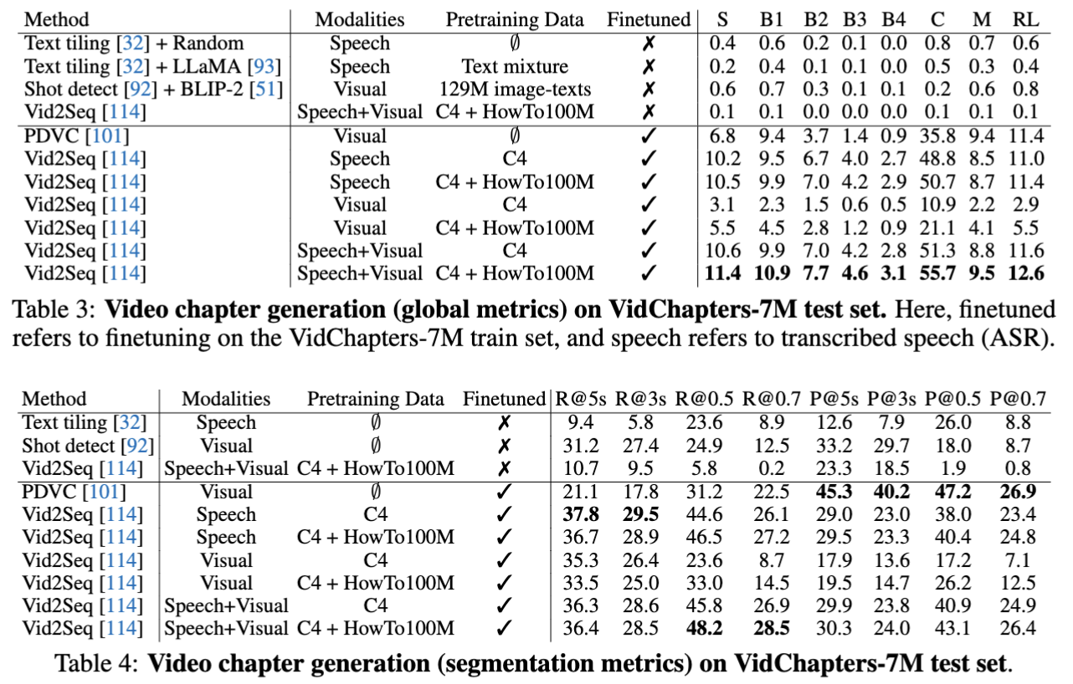
Video chapter generation

Slide 9
Qualitative examples: speech helps

Slide 10
Qualitative examples: vision helps

Slide 11
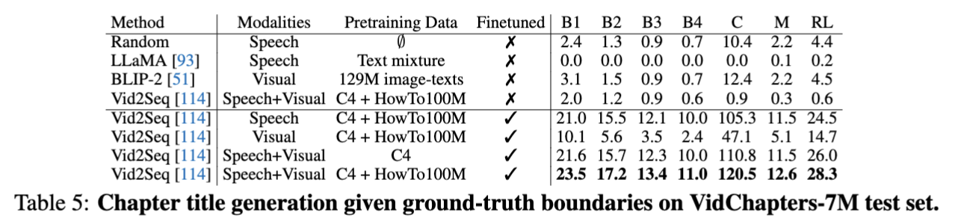
Video chapter generation given GT boundaries

Slide 12
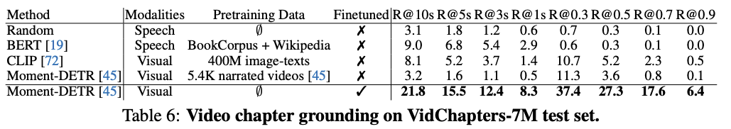
Video chapter grounding

Slide 13
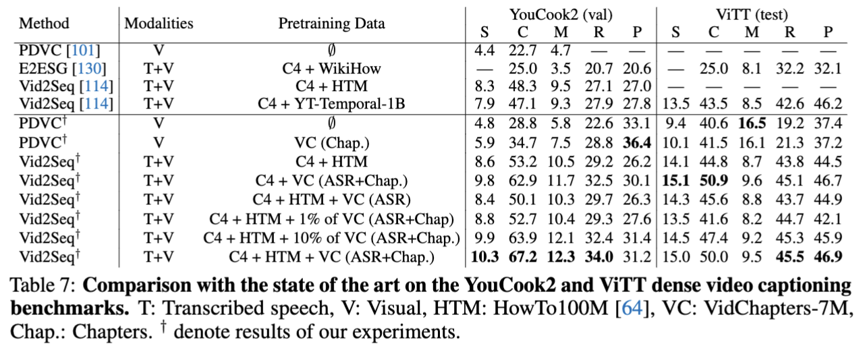
Transfer to dense video captioning

Slide 14
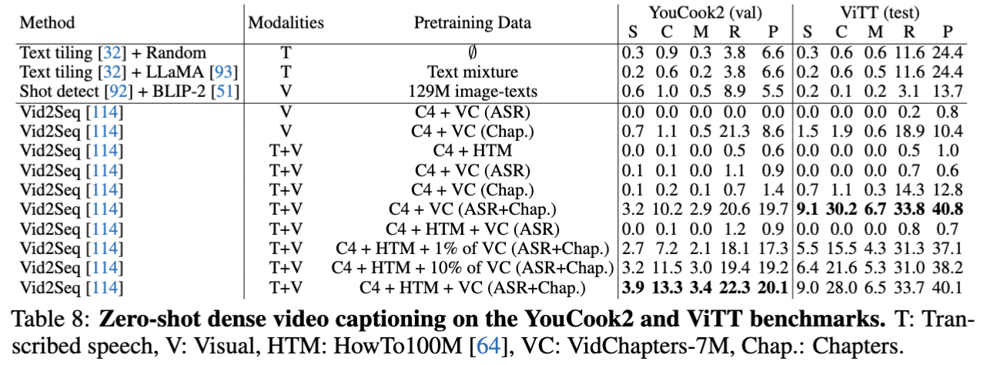
Zero-shot dense video captioning

